Slide 1
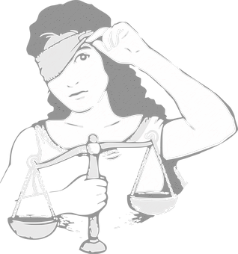
Tipping the Scales of Justice
Analyzing Supreme Court Case Opinions

Slide 2
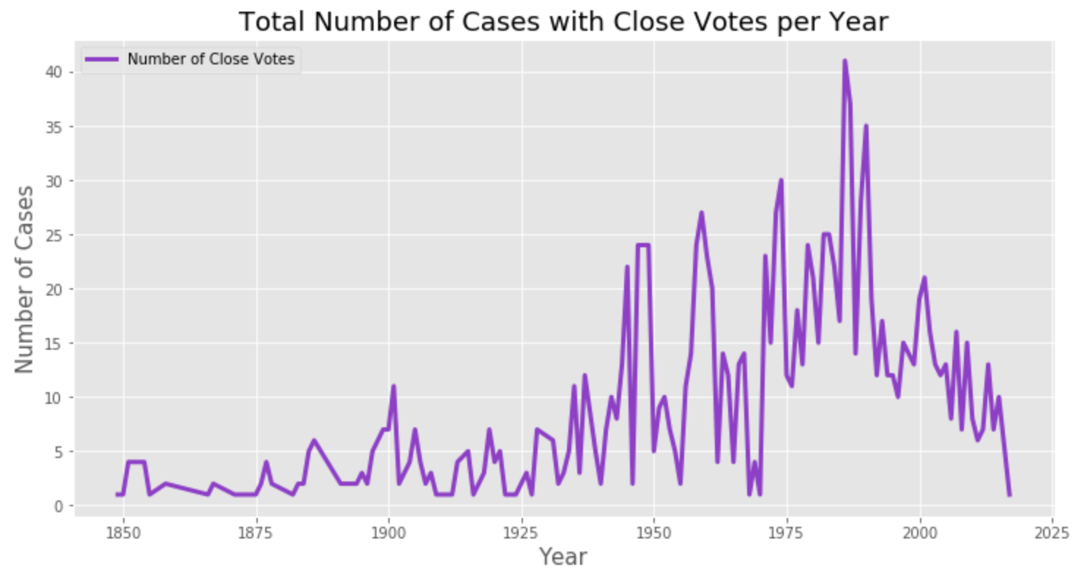
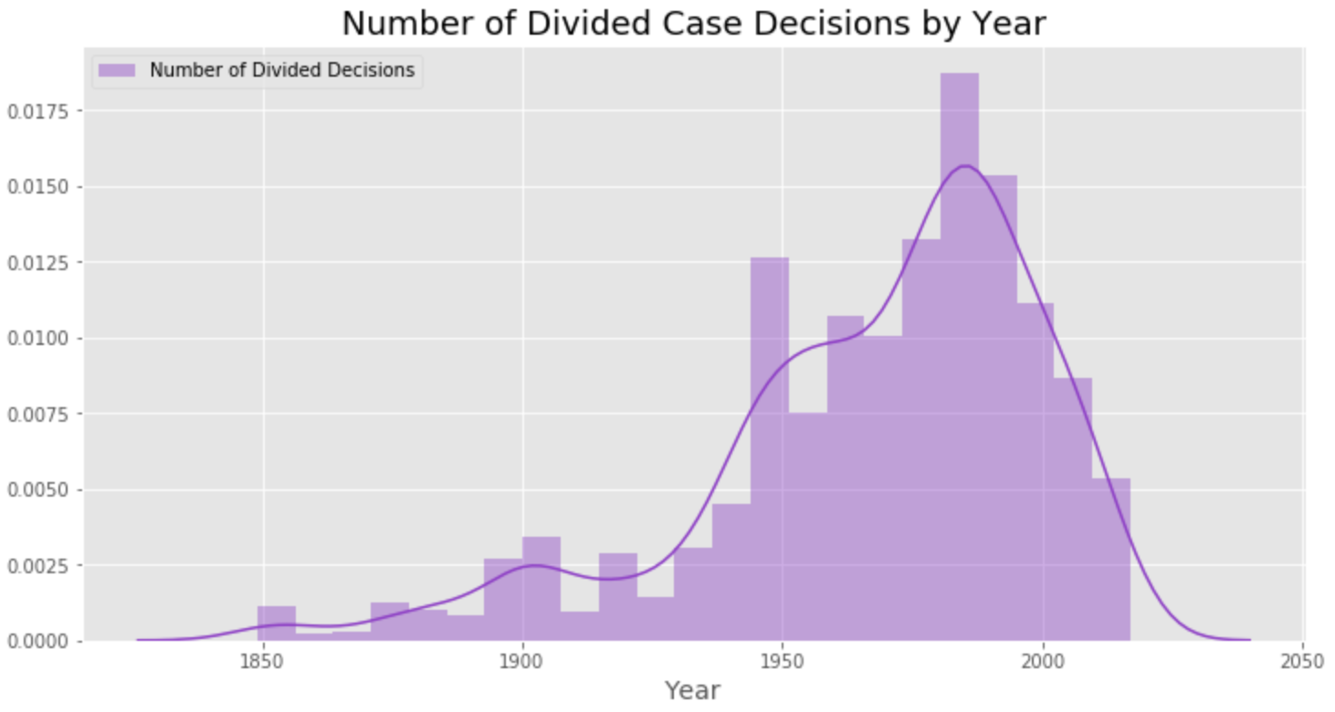
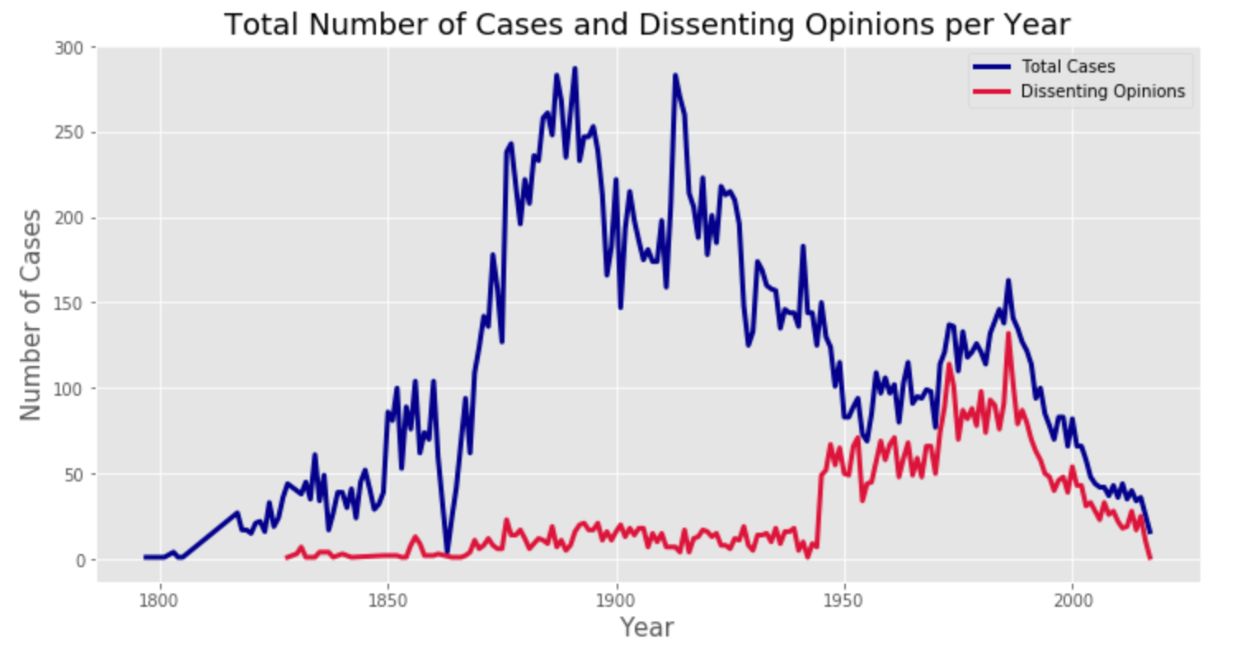
Purpose
Three main categories of legal philosophy
Increase in divided decisions and dissenting opinions over the past several decades
Tailoring an argument towards the legal ideology of a swing justice to tip the decision on a case

Slide 3
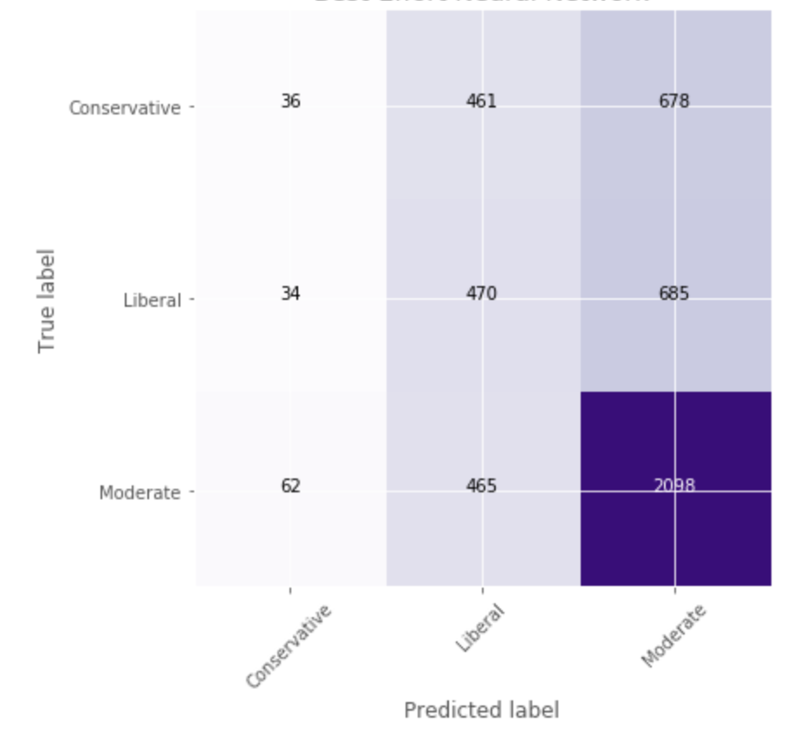
Methodology
31,000 SCOTUS case opinions from 1789 to 2017
Ideologies based on Segal and Cover scores
Recurrent Neural Network to classify documents based on ideology of the author
Confusion matrix and accuracy scores

Slide 4
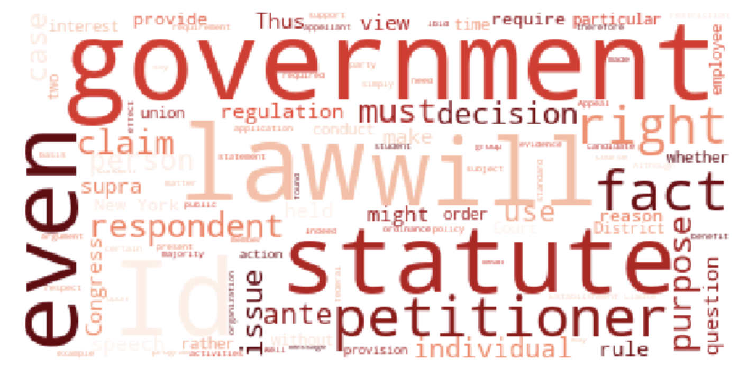
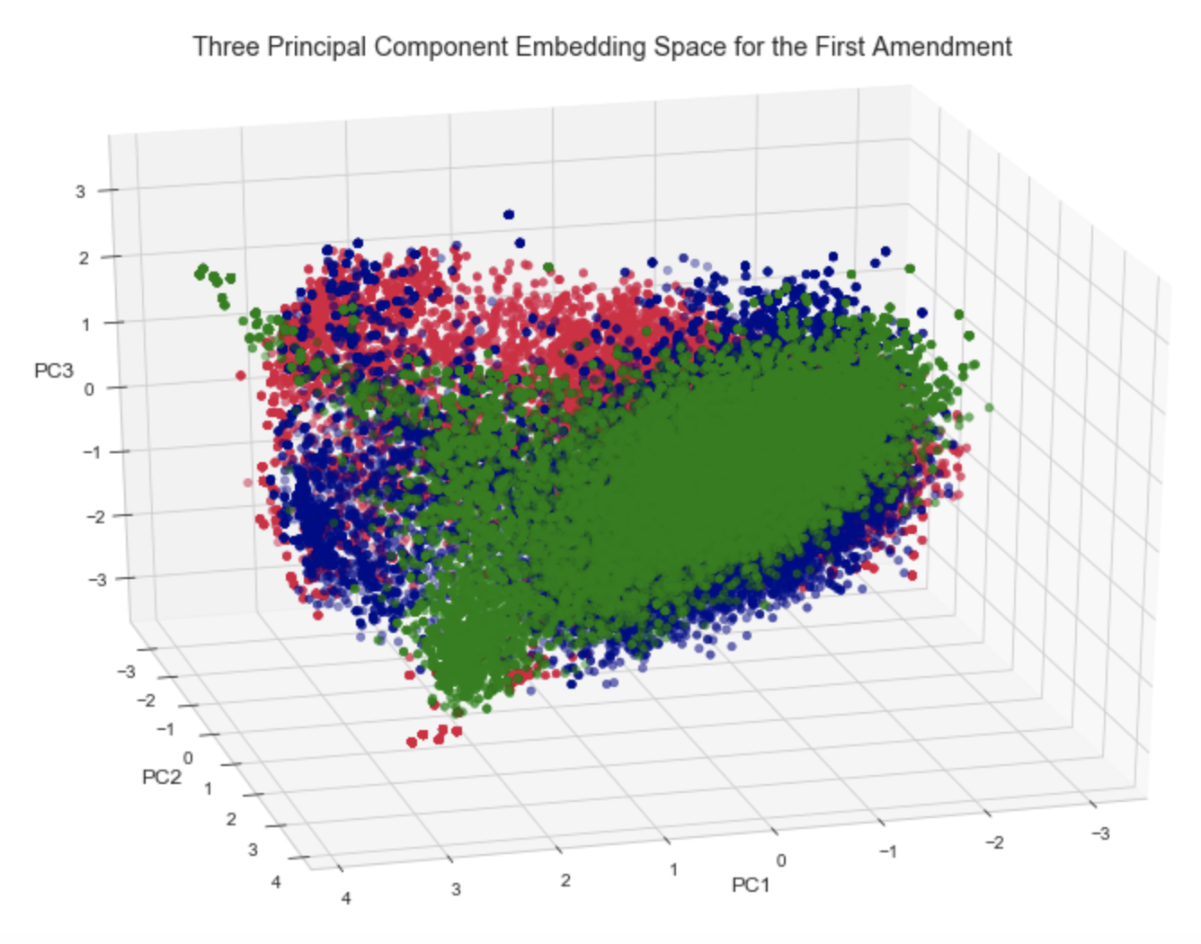
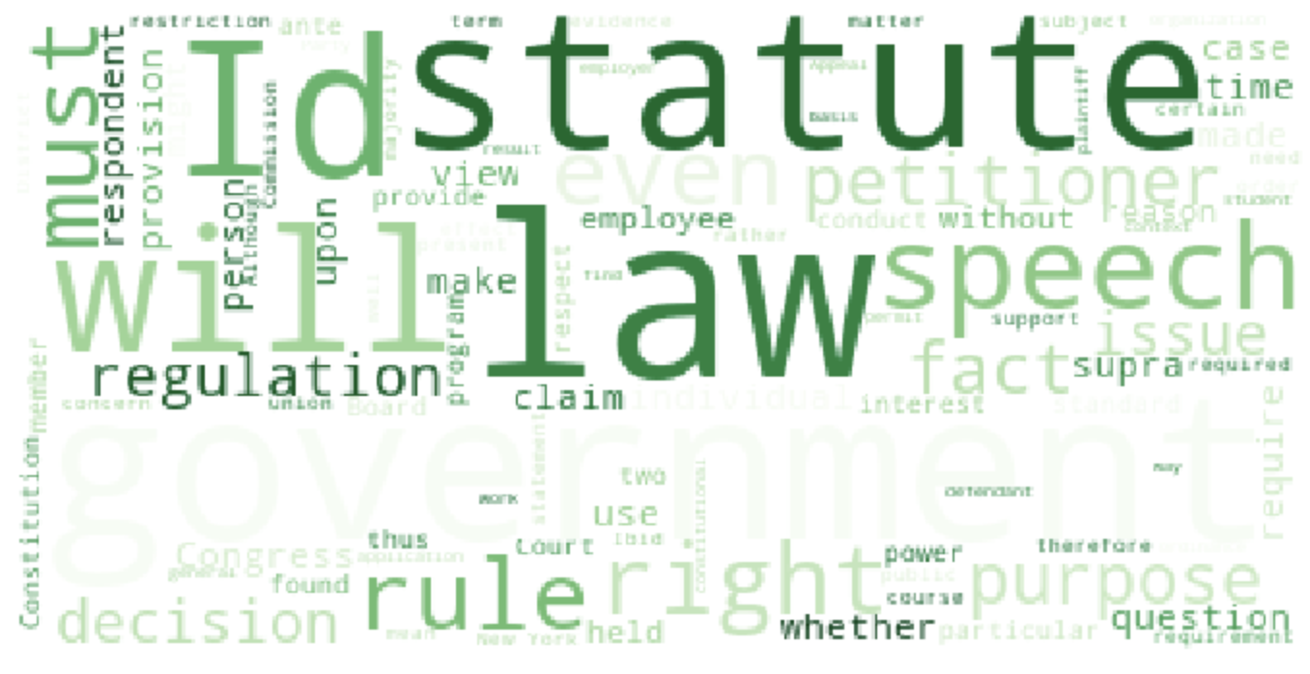
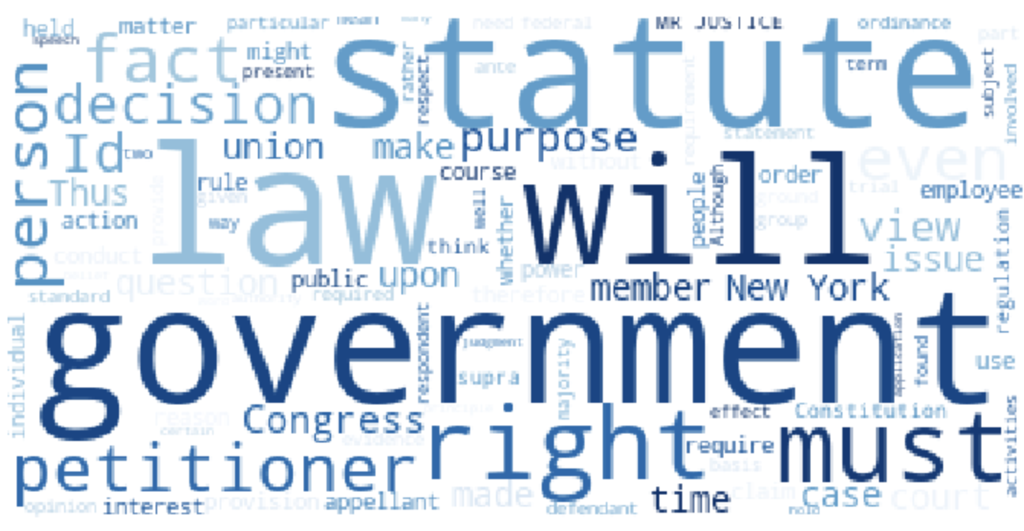
First Amendment

Slide 5
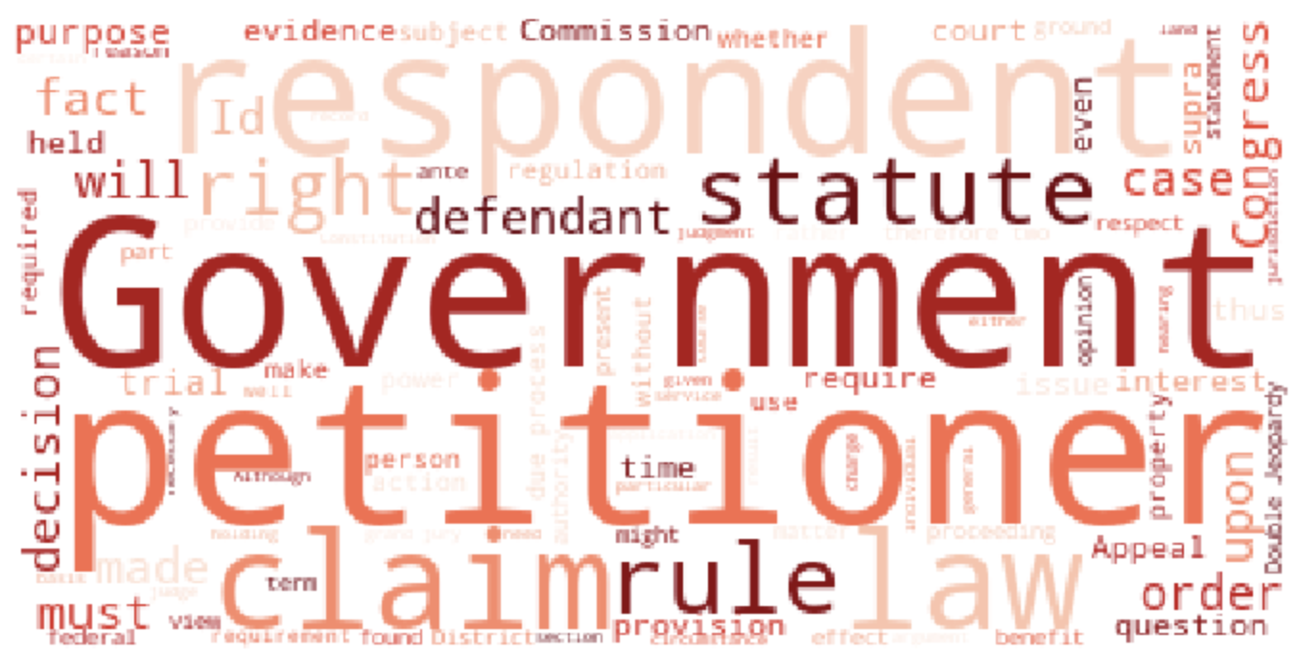
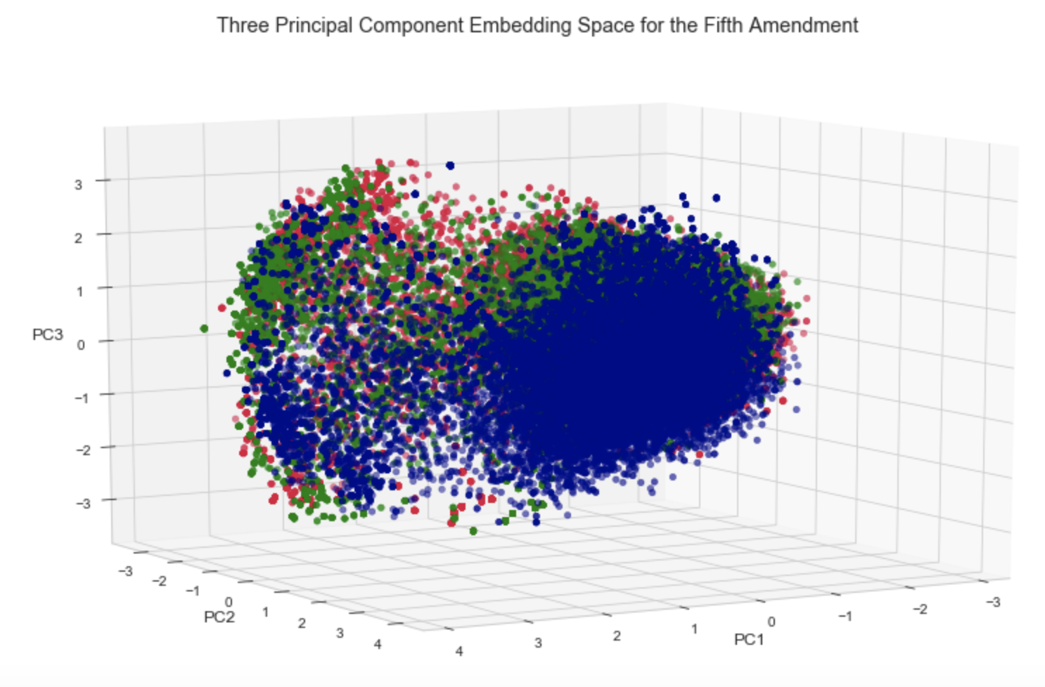
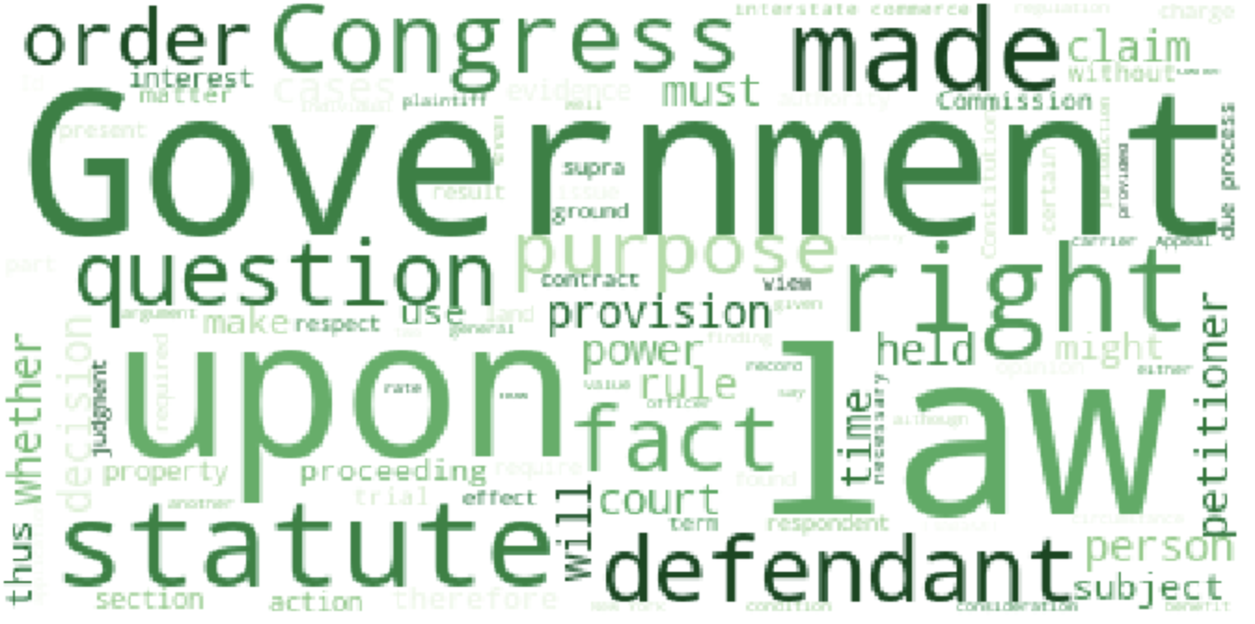
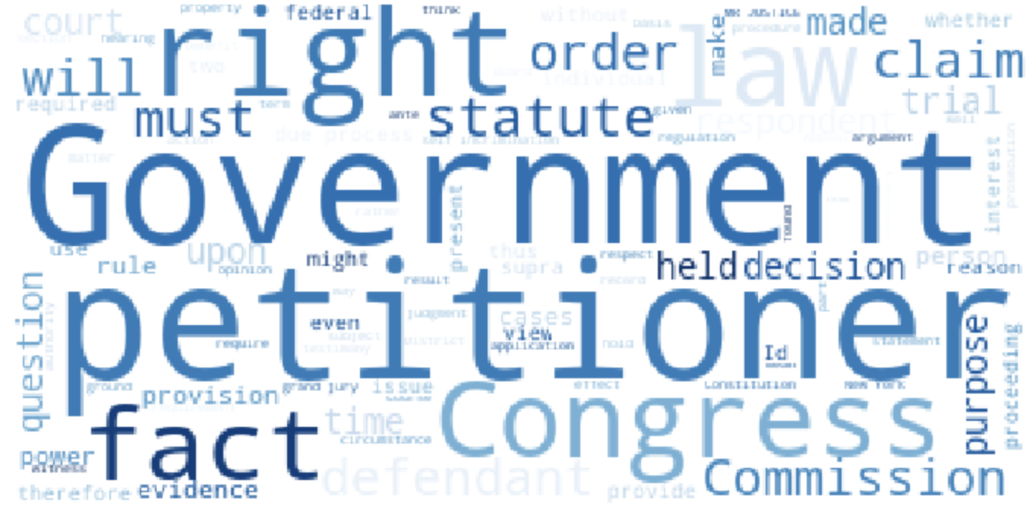
Fifth Amendment

Slide 6
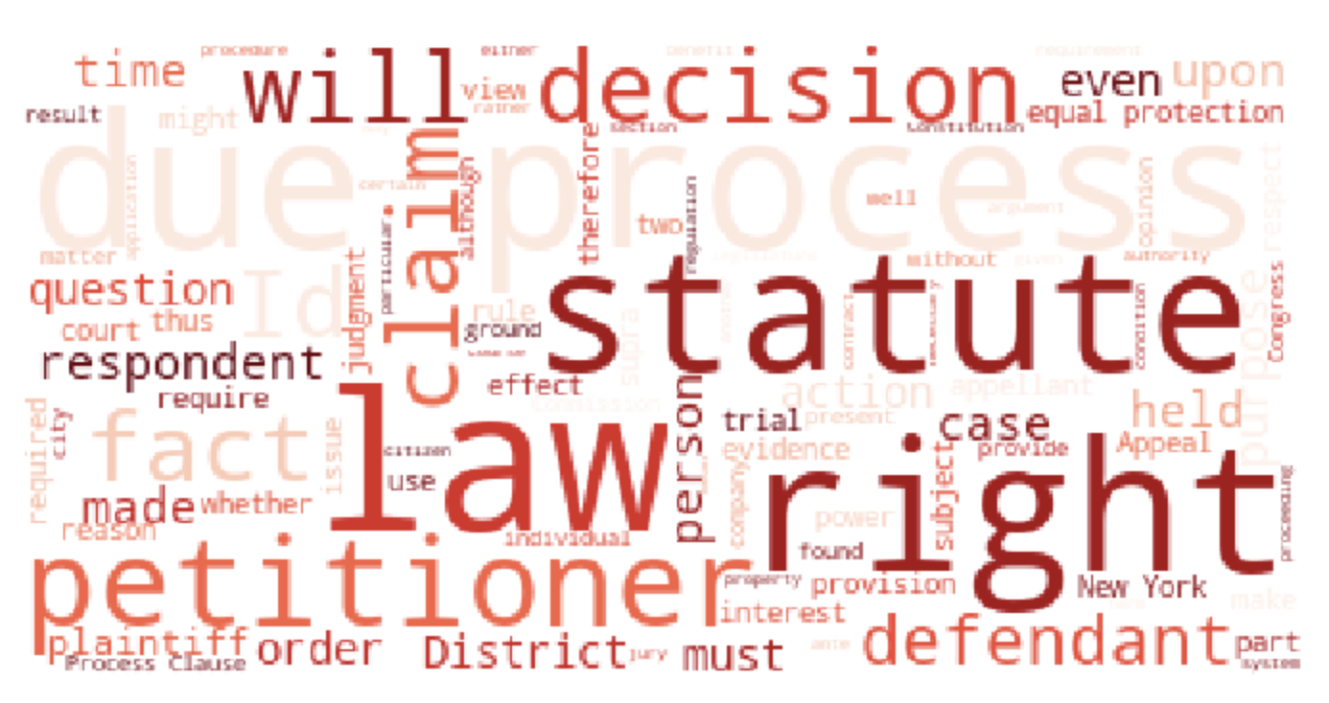
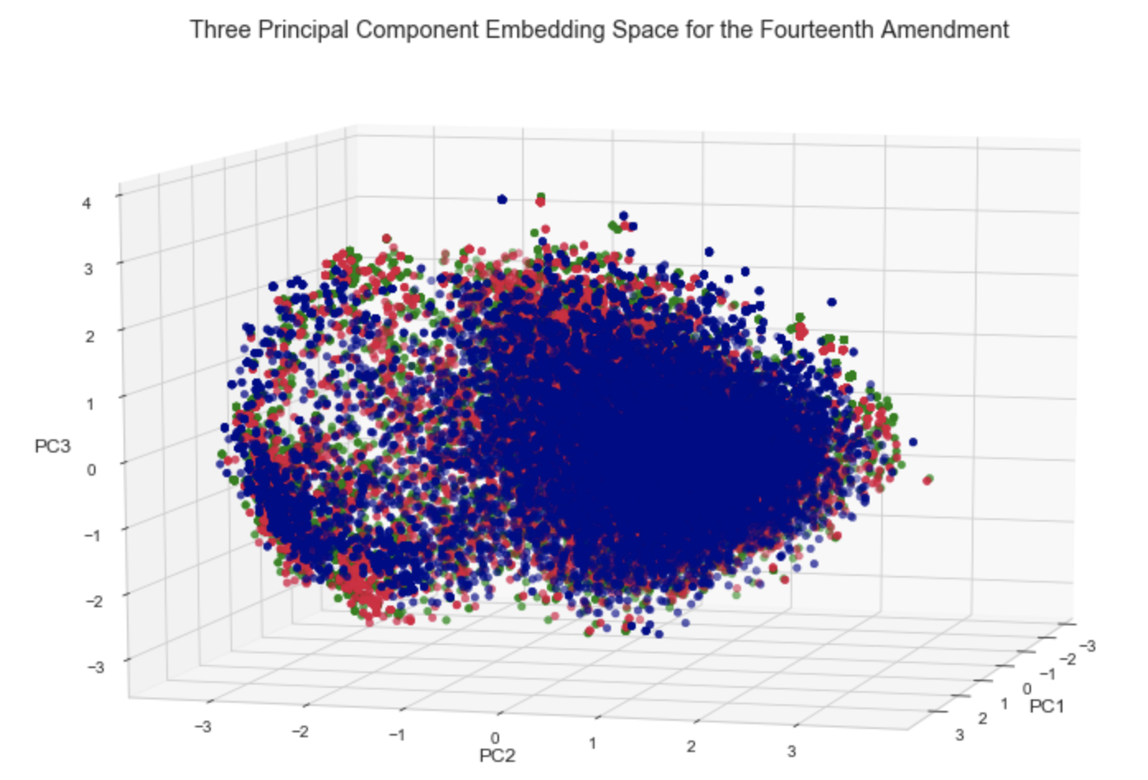
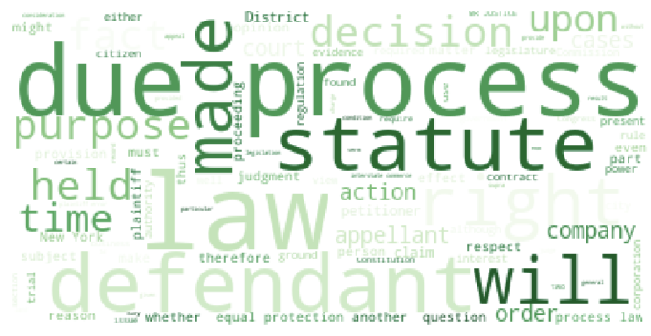
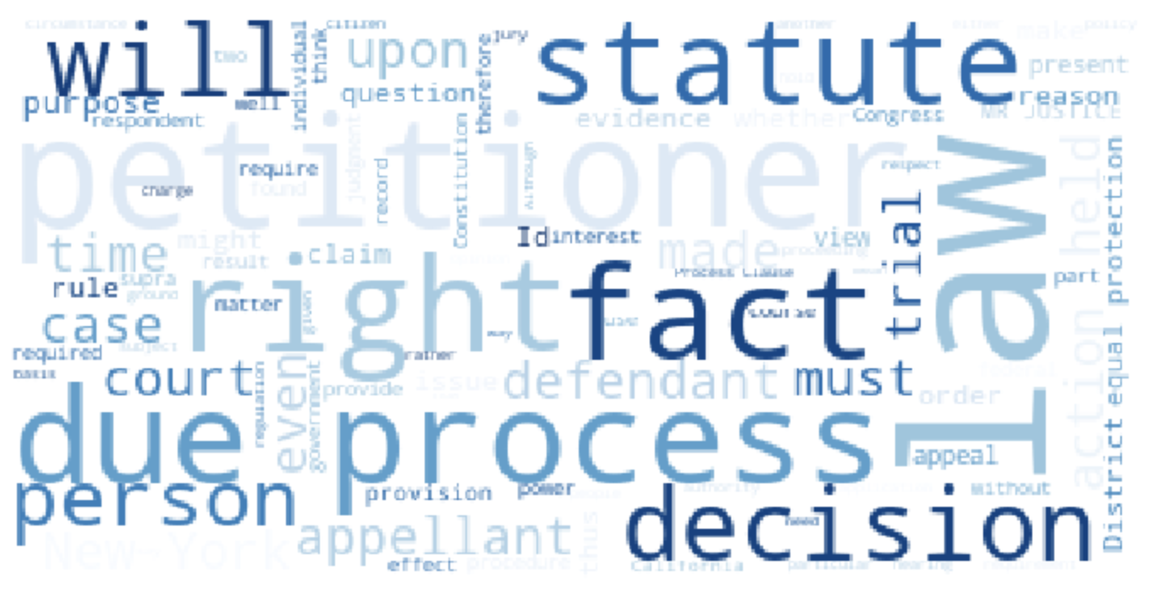
Fourteenth Amendment

Slide 7
Recommendations
Classify the ideology of the presiding justice prior to developing case argument
Know what is important to your opposition in order to win them over
Tailor case arguments to ideology of presiding justices

Slide 8
Future Work
Isolate and analyze case opinions for cases where the decision was not unanimous
Does matching the ideology of the lawyer with that of the judge affect case outcome?
Extend findings to lower court justices

Slide 9
Thank You
Questions?

